Slide 1
Exploring Product Sales and Marketing data
Introduction to Social Media Marketing
Group Members:
Lovepreet Singh 18110094
Mrityunjay Saraf 18110103
Yash Arun Meshram 18110192

Slide 2
Objective:
To perform the analysis on different marketing methods opted by different biscuit brands and their impact on sales
Price, Sales comparison of different brands
Analysis of marketing strategies used by each brand.

Slide 3
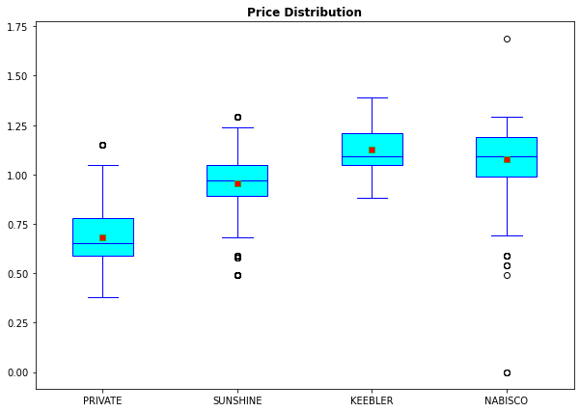
Company | Price_Mean | Price-Sd | Price_CV
PRIVATE | 0.6807290014 | 0.12407 | 0.18225
SUNSHINE | 0.9570321724 | 0.13292 | 0.13889
KEEBLER | 1.125938603 | 0.10638 | 0.094478
NABISCO | 1.079225374 | 0.14478 | 0.13415
This graph tells us the distribution of the price of brand when someone BUY or NOT_BUY their product.
Insights:
Keebler’s average product price is higher as compared to the other three.
Nabisco is more flexible with price range as it is more scattered or have a higher standard deviation.
Keebler haven’t experimented much with its product prices. Because we have a symmetric distribution with no outliers.

Slide 4
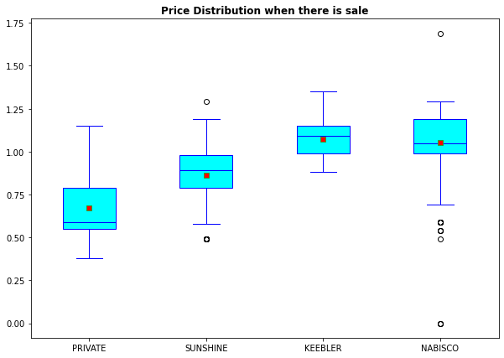
Insights:
Nabisco has many outlier therefore Nabisco is experimenting with pricing to attract consumers.
Mean selling price of private is lower whereas, Keebler has higher mean selling price.
This graph tells us the distribution of the price of the band ONLY when someone BUY their product.

Slide 5
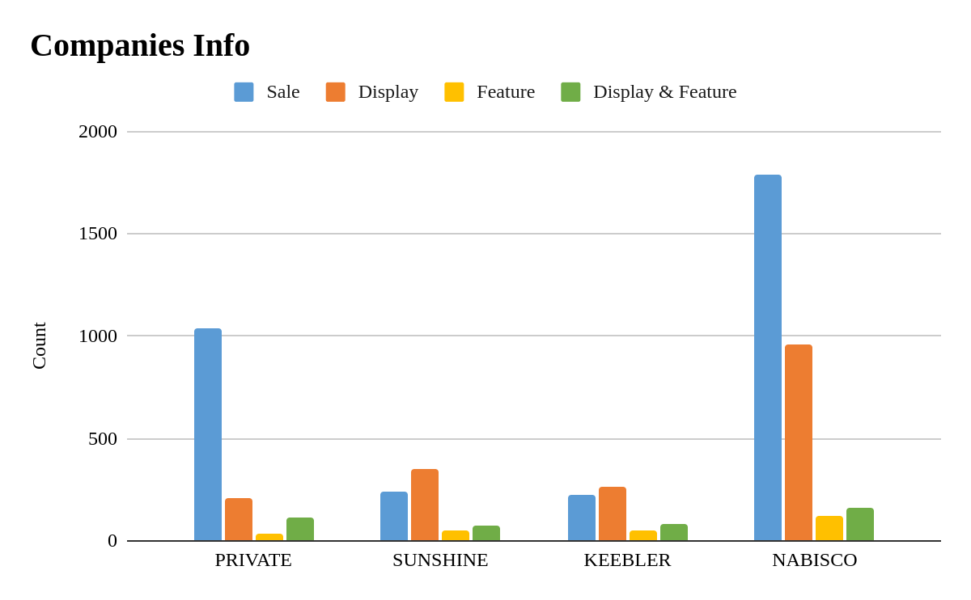
Insights:
Private brand of the store has high number of sales with less marketing as compared to the Sunshine and Keebler brands.
Both Sunshine and Keebler are spending more on marketing as compared to the revenue generated through the sales.
Nabisco is top performer among all with higher number of sales with high spending on Display marketing.
It can be seen that all four are spending more on Display mode of marketing instead of featuring in the magazine.

Slide 6
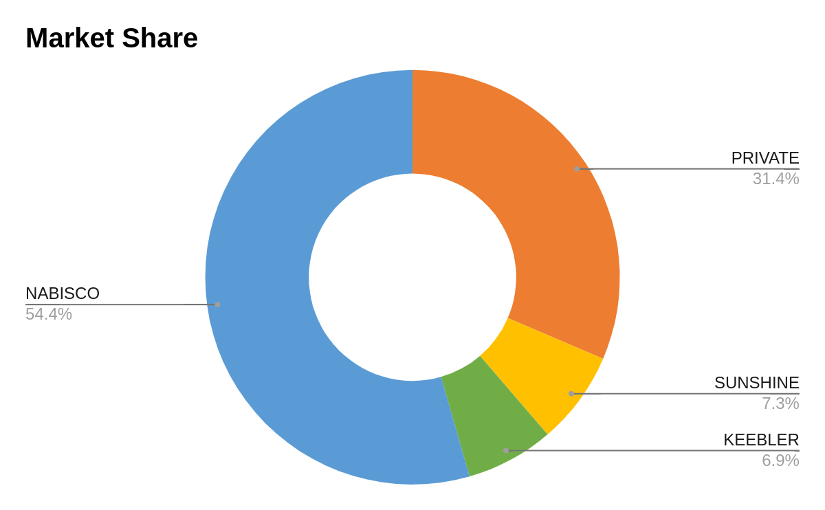
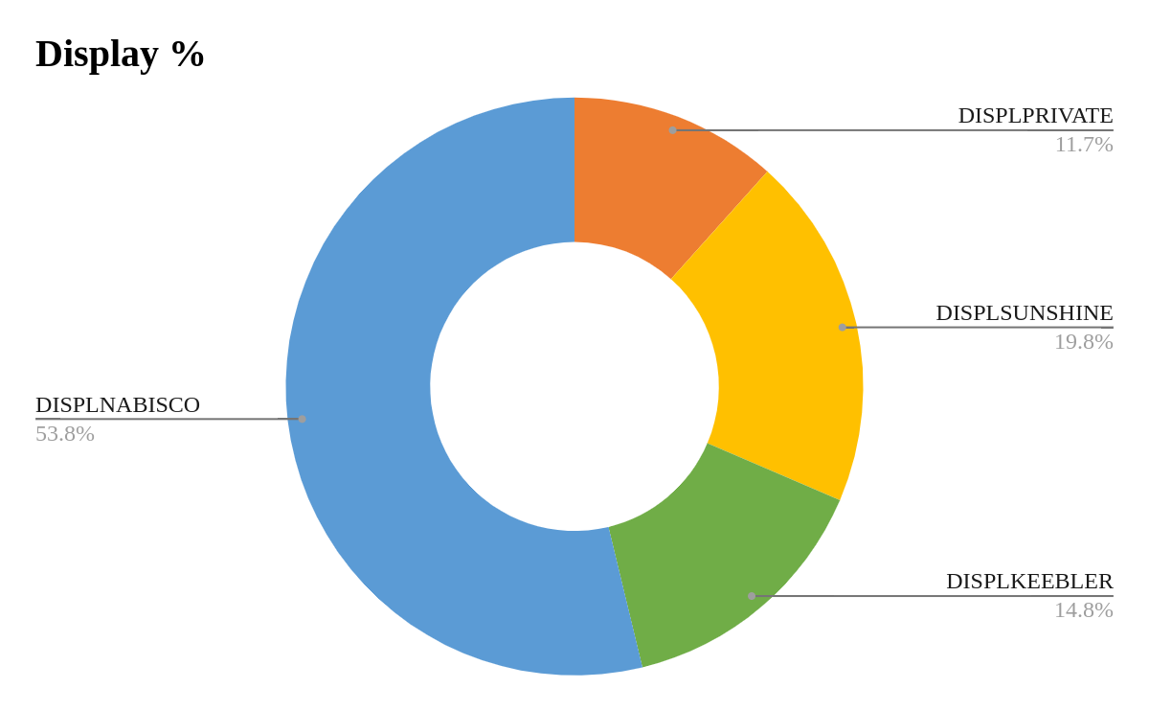
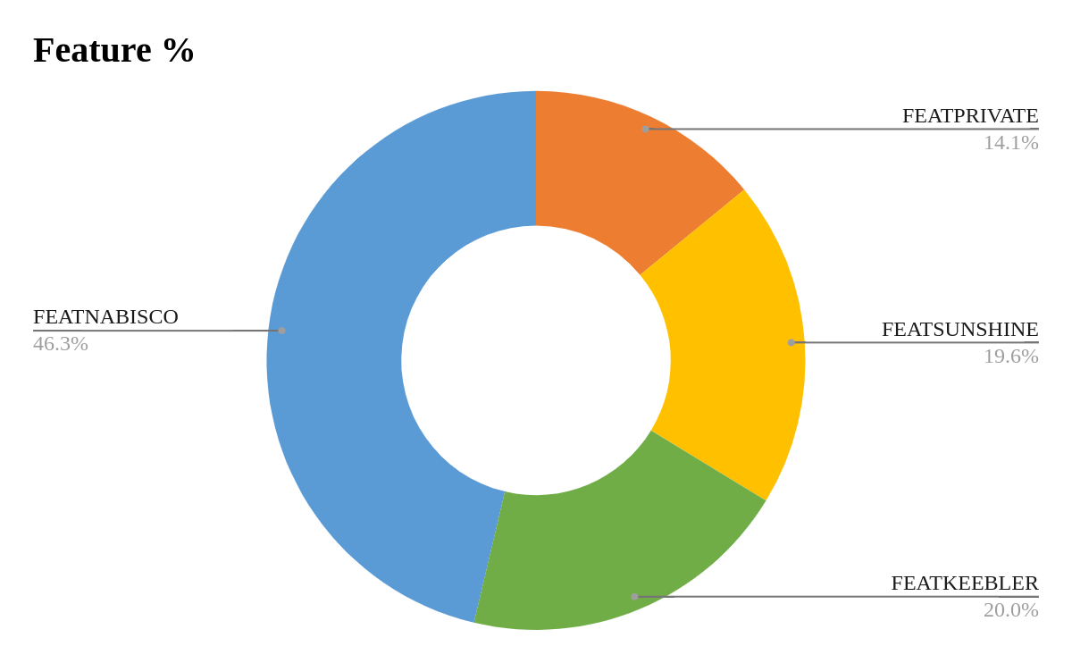
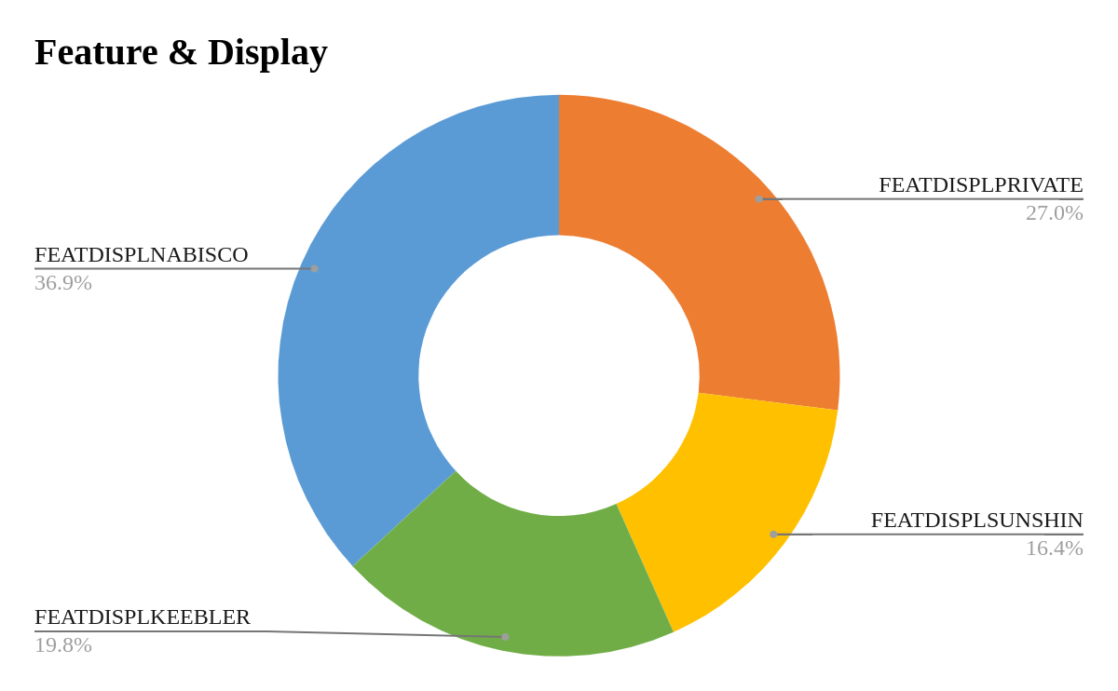

Slide 7
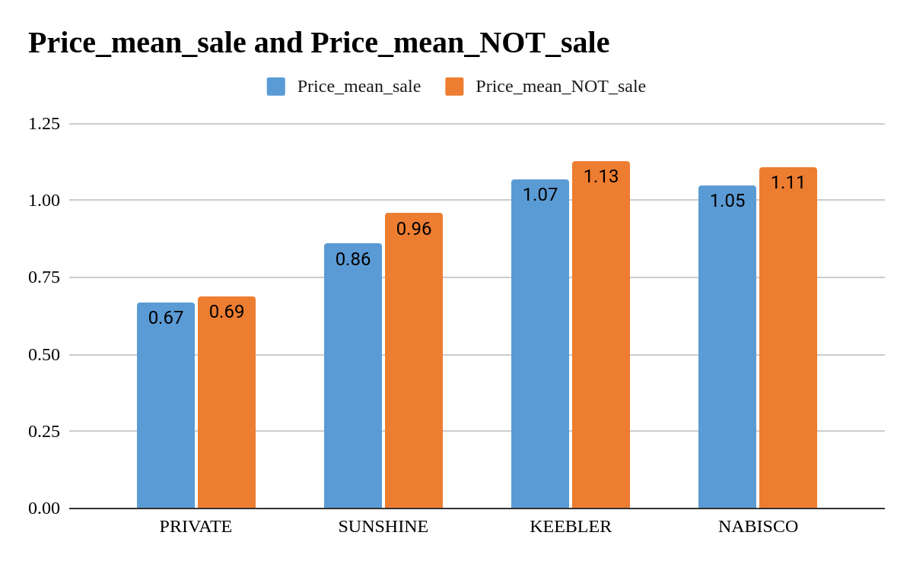
Consumer tends to buy product at the lower prices.
Sunshine tends to lower selling price more as compared to other brands, we may say that sunshine has lower brand value as compared to others.

Slide 8
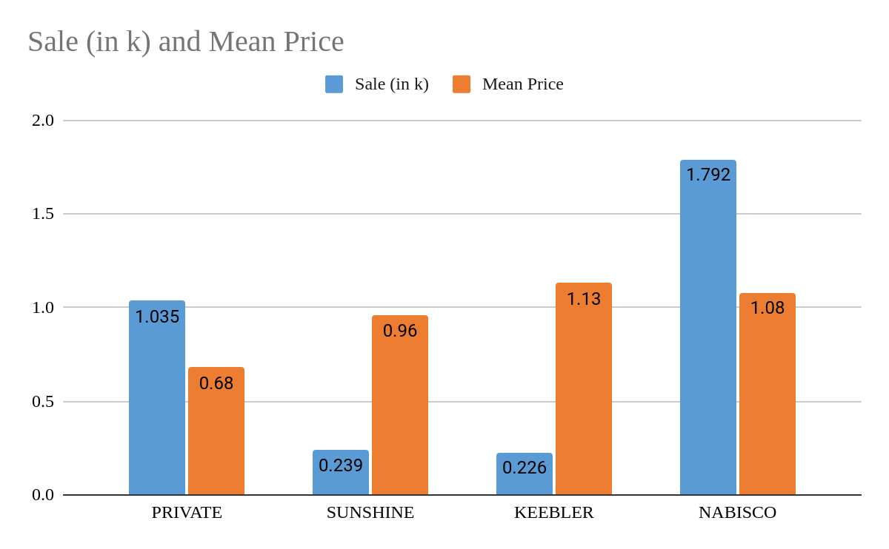
Sales vs Mean price
As we can see that average price in increasing and sales are decreasing but in case of Nabisco the sales increased at comparatively higher price.
Questions:
From the above we can see that the Nabisco has comparatively higher pricing and also the higher sales as compared to other companies. So how Nabisco manage to do so?
On the other hand Private which have lowest price yet have lower sales than Nabisco?

Slide 9
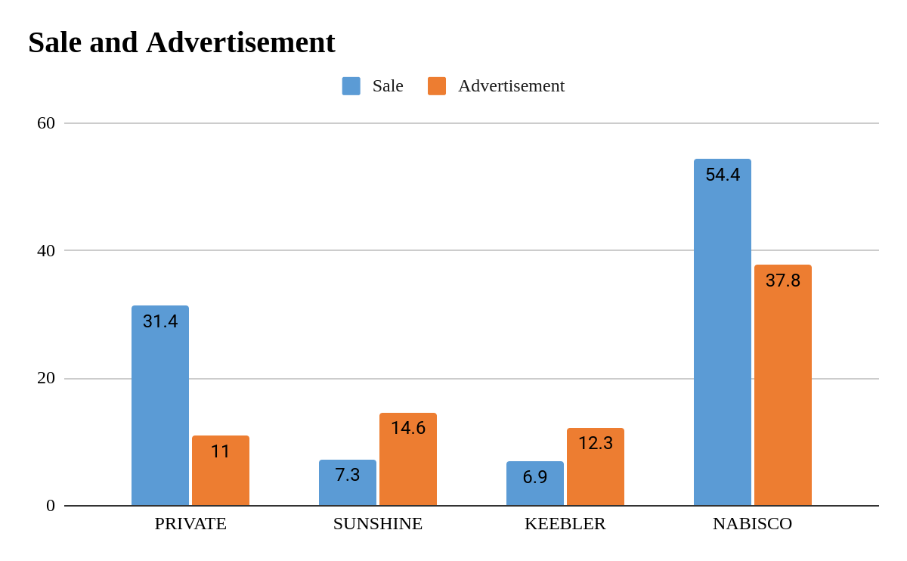
Insights:
Nabisco has highest market share with more spending on marketing/advertising.
Private brand is spending very less and yet bringing the sales and have a significant market share. It has less mean Product Price as compared to the other three.
Both Sunshine and Keebler are unable to generate profits it seems as they are spending more on advertisement.

Slide 10
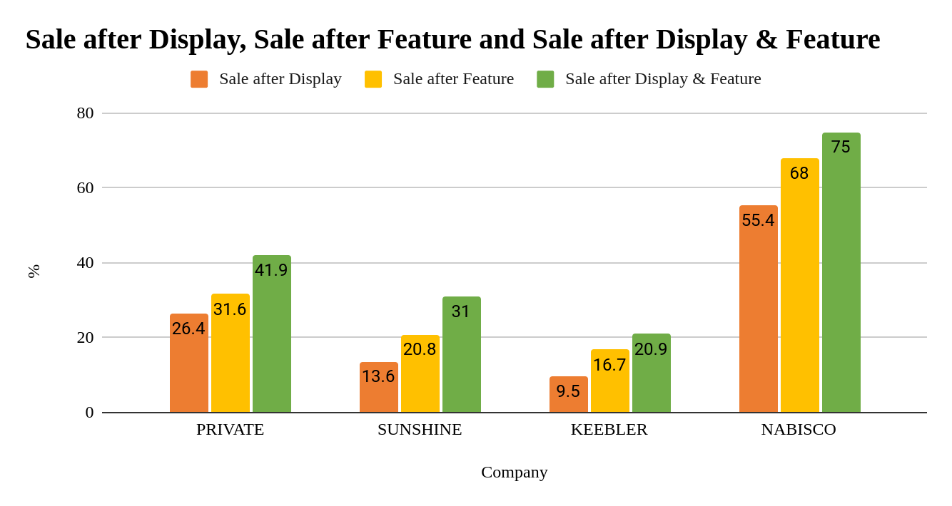
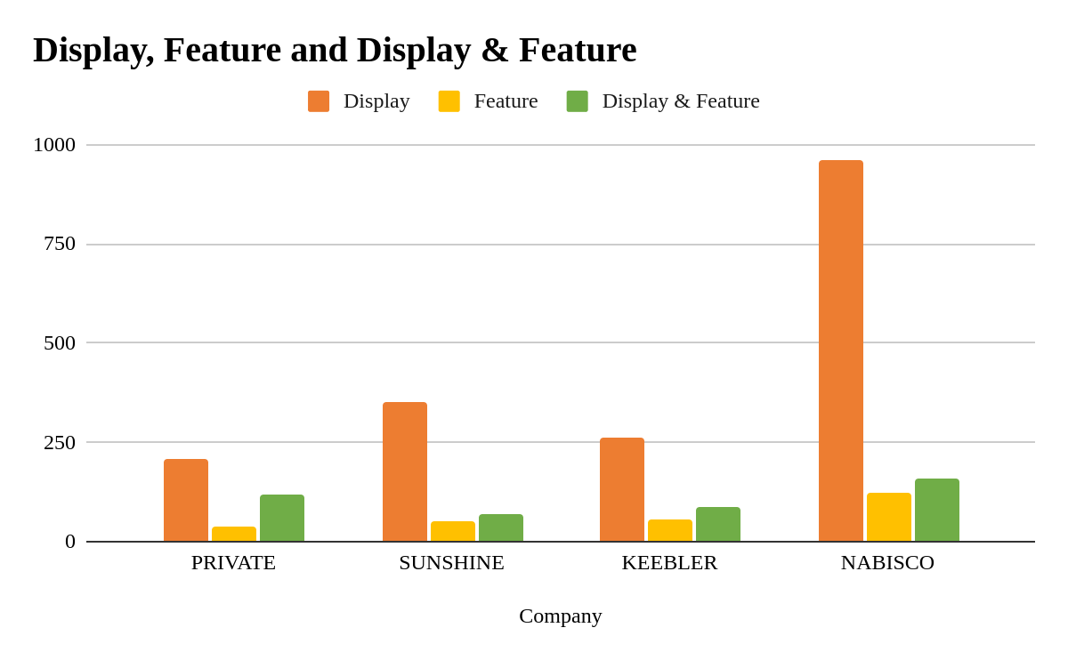
NABISCO gaining more profit by their advertisement
On the other hand KEEBLER is performing bad compare to other
Display & Feature marketing strategy seems to be more profitable but as we had seen earlier the Display method is used in large number

Slide 11
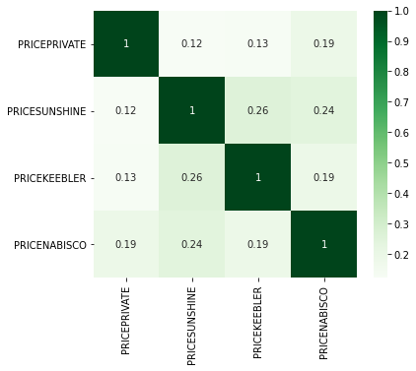
Does Price of One Brand affects the Price of another brand?
As we can see that there is negligible correlation between the prices of brand. Thus, Price of one brand doesn’t depends on the other’s brand price.
So, Brand price is changing independently of one another.
Correlation Matrix

Slide 12
THANK YOU

